Slide 1
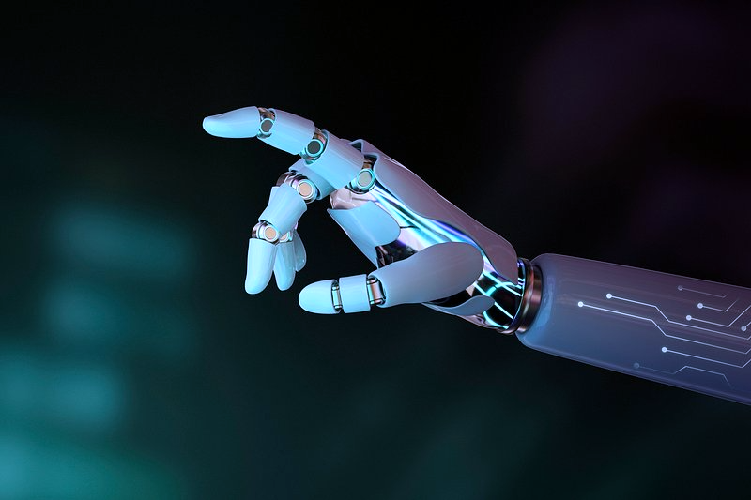
Sign Language To Text
Oren Raz and Lam Kai Yi Karen

Slide 2

The DEMO

Slide 3
Improvements to Interface
Frontend and Backend linkage
Work on Docker implementation
Ensure smooth connection between Front and Backend
Now it is easy*: simply type docker compose up and go to
localhost:8080 on your browser.
*Easy: assuming you have docker and docker compose installed, and access to the repository which is currently private, and a browser, and a computer.

Slide 4
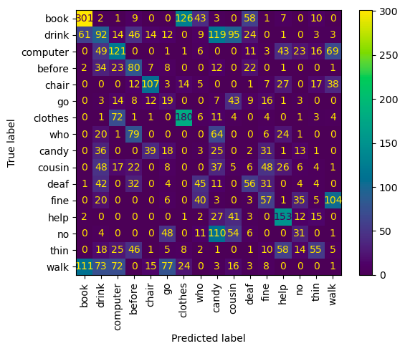
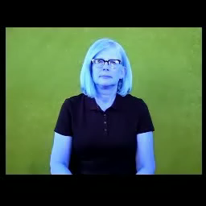
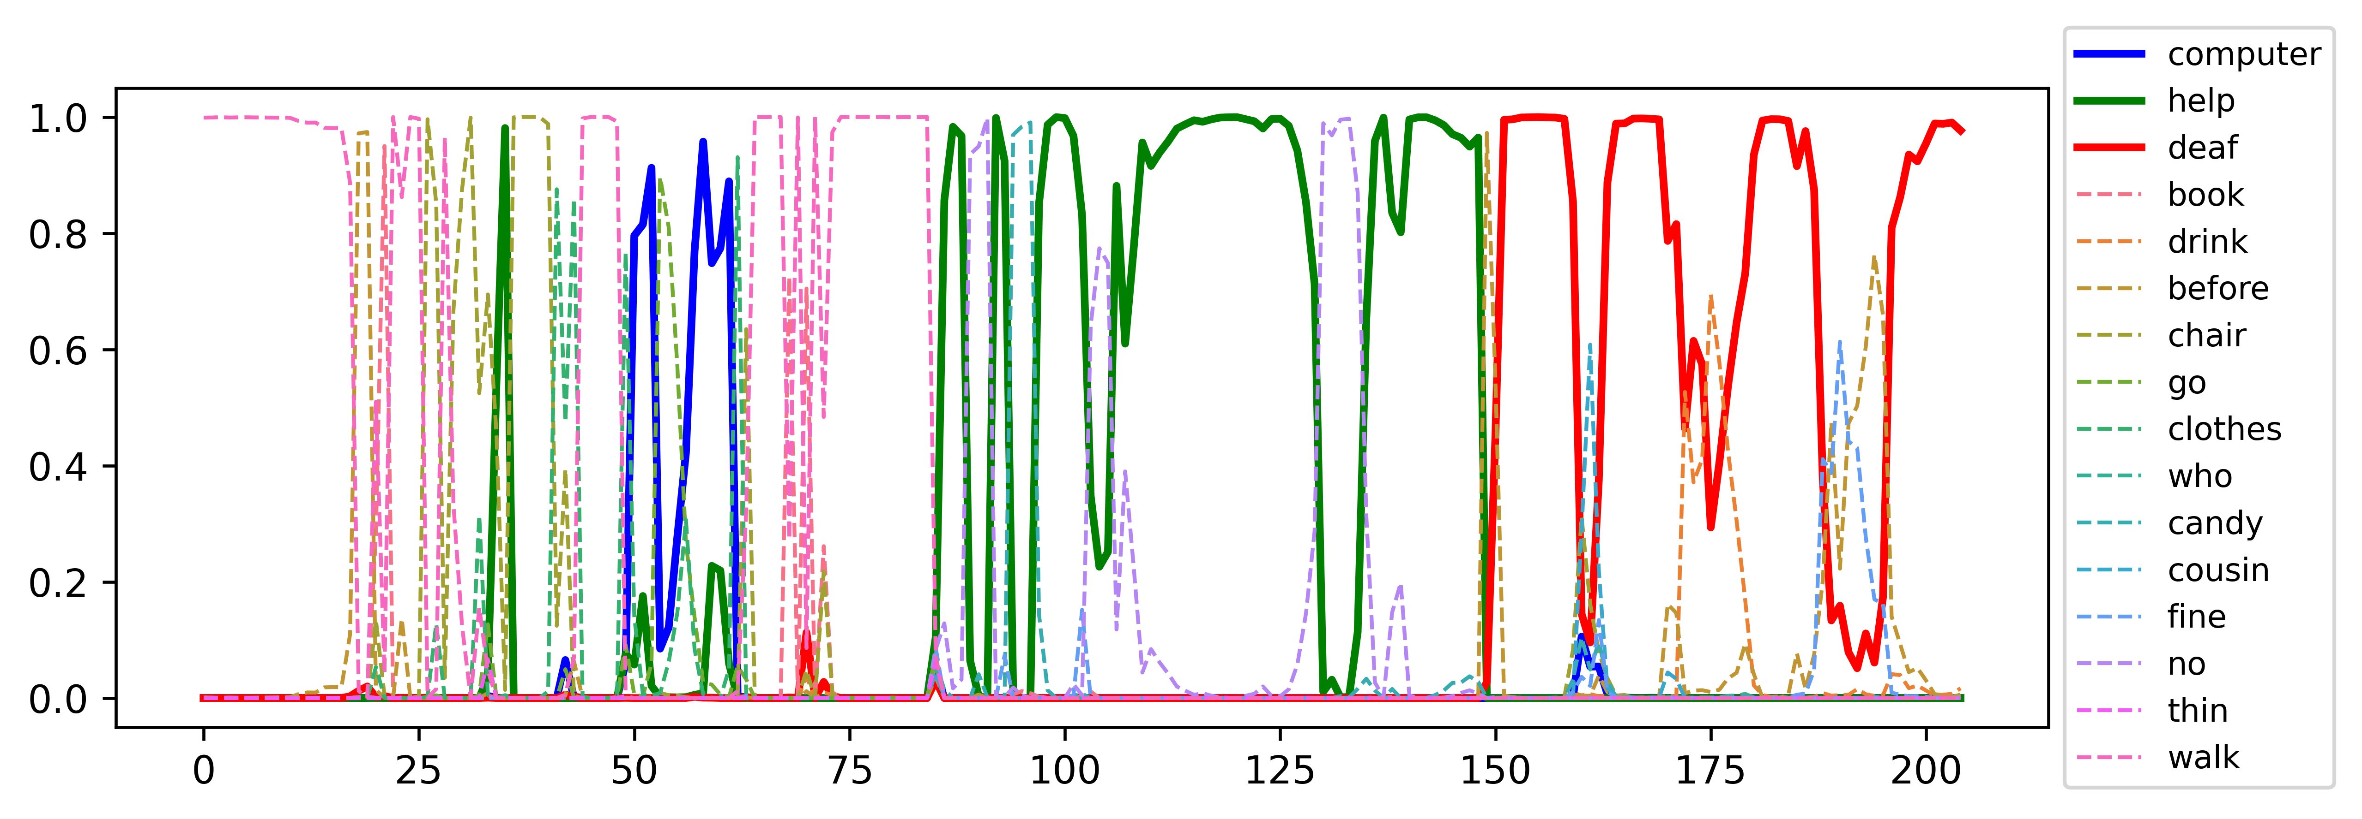
New Model Idea
CNN for each frame, output probabilities:
Sentence video:
Computer help deaf

Slide 5
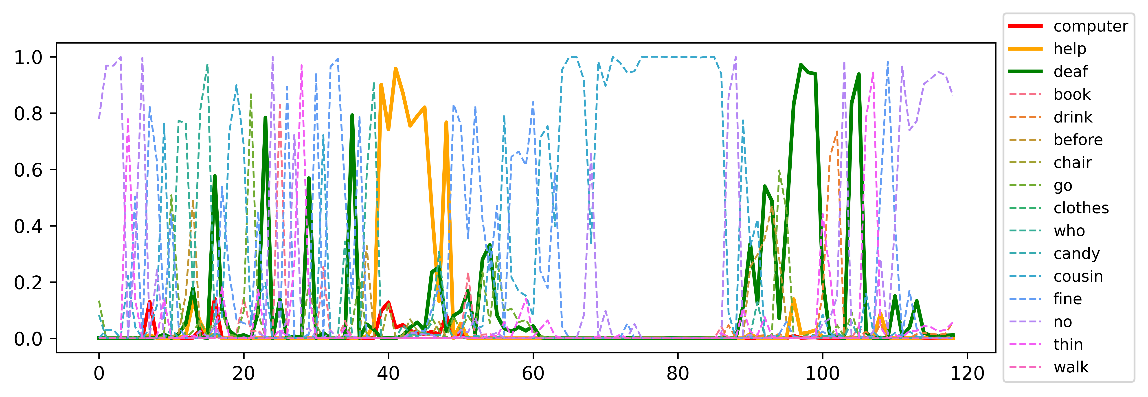
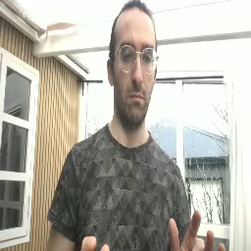

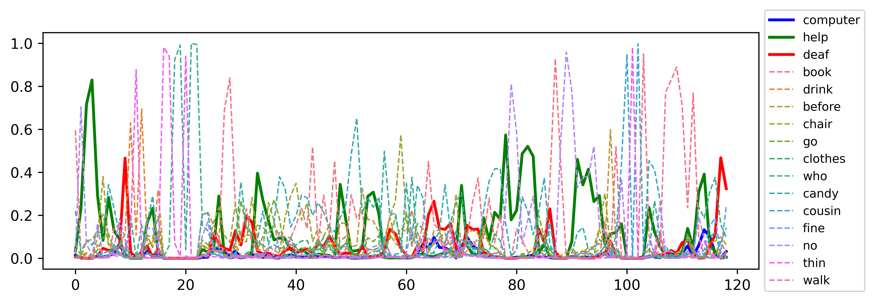
Noise video:
Waving hands randomly (video not attached)

Slide 6
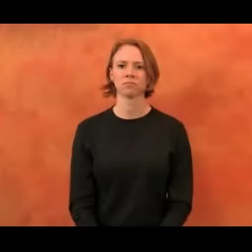
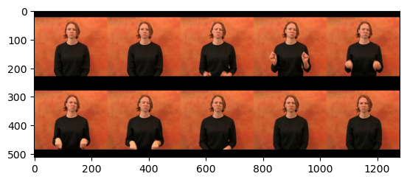
Improvements to Model
New Attempts: CLIP Embedding + Classification Model
CLIP
Select 10 frames
Embedded using
Select 10 frames
00376.mp4
Classification Model
Output
word: able

Slide 7
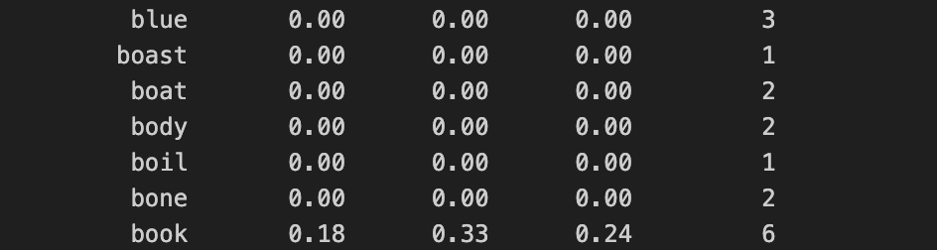
Improvements to Model
New Attempts: CLIP Embedding + Classification Model
Classfication Model | Accuracy
Logistic Regression | 0.02196
Support Vector Machine | 0.03549
Random Forest | In Progress
CNN (With CLIP Embedding) | In Progress
CNN (Without CLIP Embedding) | In Progress
PROBLEM: Extremely Low Accuracy
Example of Results
Possible reasons? 500 classes -> Models too simple for the complexity of the task

Slide 8
Future Work and Ideas
#1 Work on the UI to accept a live recording (using dummy model)
#2 Improve all our 3 current models and try to choose the best one.

